Slide 1

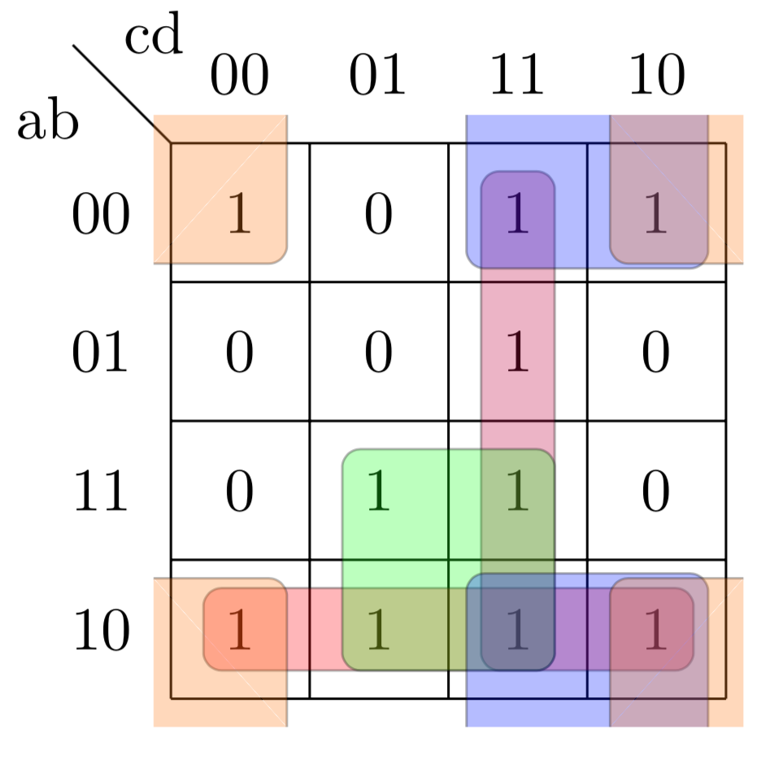
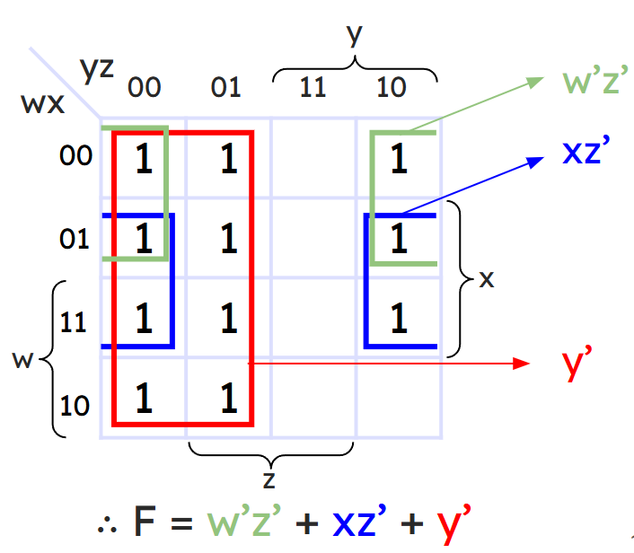
Department of Computer Science and Engineering, BRAC University
Lecture 5
Karnaugh Maps
CSE260 : Digital Logic Design

Slide 2
The map method
The map method provides a simple procedure for minimizing Boolean functions.
The map is made up of squares where each square represent a minterm.
We represent each minterm of an equation by ‘1’s
We groups the adjacent ‘1’s in groups of 2, groups of 4 or groups of 8 and so on.
In those grouping try to find the common literal.
The map method is often known as Karnaugh Map or Veitch Diagram. In short we will call it K-map
y
x
m₀ | m₁
m₂ | m₃
x’y’ | x’y
xy’ | xy
‹#›
Department of Computer Science and Engineering
CSE260 - Digital Logic Design

Slide 3
K Map Grouping Rules:
Group the adjacent '1's in groups of 2, 4, 8 and so on [2^n].
Take maximum number of 1 if possible.
You can cover a 1 multiple times only if that covered 1 can help another uncovered 1 to get covered.
Our target is to group all the '1's.
In case of "don't care" we can consider 'X' to create groups alongside '1's. Other rules stay same as always.
However, you cannot create groups with 'X's only. 'X' can be only used to create groups if it is helping any uncovered '1's.
‹#›
Department of Computer Science and Engineering
CSE260 - Digital Logic Design

Slide 4
Two variable map
There are 4 minterm of 2 variable; hence the map is four squares, one for each minterm.
Only 1 bit changes
y
x
00 | 01
10 | 11
m₀ | m₁
m₂ | m₃
x’y’ | x’y
xy’ | xy
Only 1 bit changes
‹#›
Department of Computer Science and Engineering
CSE260 - Digital Logic Design

Slide 5
Representing function in K-map
(a) F1=xy;
(b) F2=xy’+xy+x’y
= x(y’+y)+x’y
= x+x’y
= (x+x’)(x+y)
= (1)(x+y)
= x+y
y
y
y
y
x
0 1
0 1
x
 | 1
 | 1
1 | 1
0
1
0
1
x
x
‹#›
Department of Computer Science and Engineering
CSE260 - Digital Logic Design

Slide 6

Try it yourself
F=xy’+x’y’+x’y,
Simplify the equation using k-map
Solution:
F=xy’+x’y’+x’y=x’+y’
y
y
x
0 1
1 | 1
1
0
1
x
‹#›
Department of Computer Science and Engineering
CSE260 - Digital Logic Design

Slide 7
Three variable map
Sequence in 3-variable map is not in binary sequence but in reflected code. Here, at a time only 1 bit changes from 0 to 1 and 1 to 0.
Numbering of minterms follow binary numbers.
Example m5 is at 101 i.e. row 1 and column 01.
y
y
yz
yz
00 01 11 10
x
00 01 11 10
x
m₀ | m₁ | m₃ | m₂
m₄ | m₅ | m₇ | m₆
000 | 001 | 011 | 010
100 | 101 | 111 | 110
x’y’z’ | x’y’z | x’yz | x’yz’
xy’z’ | xy’z | xyz | xyz’
0
1
0
1
x
x
z
z
Note: Any 2 adjacent square differ by 1 variable ( which is primed in one and unprimed in the other )
‹#›
Department of Computer Science and Engineering
CSE260 - Digital Logic Design

Slide 8
Three variable map
If any 2 adjacent square differ by 1 variable ( which is primed in one and unprimed in the other ) and they are grouped, then any 2 minterms in the adjacent square are ORed, will remove the different term. As a result , we get a single ANDed term of only 2 common literals
F1=∑(5,7) = xy’z+xyz =xz(y’+y) =xz F2=∑(0,2) = x’y’z’+x’yz' =x’z’(y’+y) =x’z’
y
y
yz
yz
x
00 01 11 10
x
00 01 11 10
 | 1 | 1
1 |  |  | 1
0
1
0
1
x
x
z
z
‹#›
Department of Computer Science and Engineering
CSE260 - Digital Logic Design

Slide 9
Simplifying functions using k-map
F=∑(2,3,4,5)
=x’yz+x’yz’+xy’z’+xy’z
(note: in other words, F= (∑(010,011,100,101) so place ‘1’ in those positions and group the adjacent ones)
F=x’y+xy’
Grouping of 1 can be done in groups of
two ‘1’,four ‘1’,eight ‘1’.…2^{n} ‘1’.
x’y
y
yz
x
00 01 11 10
 |  | 1 | 1
1 | 1
0
1
x
xy’
z
‹#›
Department of Computer Science and Engineering
CSE260 - Digital Logic Design

Slide 10
Example
F1=x’yz+xy’z’+xyz+xyz’ =xz’+yz
011
100
111
110
y
yz
x
00 01 11 10
 |  | 1
1 |  | 1 | 1
Notice even 2 opposite edges of the map are adjacent, thus they can be grouped
0
1
yz
x
xz’
z
‹#›
Department of Computer Science and Engineering
CSE260 - Digital Logic Design

Slide 11
Example
If F=∑(0,2,4,6), then simplify it
m₀+m₂+m₄+m₆ = x’y’z’ + x’yz’ + xy’z’ + xyz
= x’z’(y’+y) + xz’(y’+y)
= x’z’ +xz’ = z’(x’+x)
= z’
000
010
100
110
y
yz
x
00 01 11 10
z’
1 |  |  | 1
1 |  |  | 1
0
1
x
z
‹#›
Department of Computer Science and Engineering
CSE260 - Digital Logic Design

Slide 12
Try it yourself
F=∑(0,2,4,5,6), Simplify it.
Solution
y
yz
x
00 01 11 10
z’
1 |  |  | 1
1 | 1 |  | 1
0
1
xy’
x
F= xy’ + z’
z
‹#›
Department of Computer Science and Engineering
CSE260 - Digital Logic Design

Slide 13
Try it yourself:
F=A’C+A’B+AB’C+BC
a) Express it as SOP (i.e. ∑)
b) Simplify it using Kmap
Solution
(a) F= ∑(1,2,3,5,7)
(b) F=C + A’B
To find A’C, coincide A’ (first row) with C( middle 2 column)
To find A’B, coincide A’ (first row) with B( last 2 column)
To find BC, coincide B (last 2 column) with C( middle 2 column)
To find AB’C, is m5( 2nd row 2nd column)
B
BC
A’B’
A
00 01 11 10
C
 | 1 | 1 | 1
 | 1 | 1
0
1
A
C
‹#›
Department of Computer Science and Engineering
CSE260 - Digital Logic Design

Slide 14
Summary of grouping in 3-variable map
One square represents one minterm, giving a term of three literals
Two adjacent squares represent a term of two literals
Four adjacent squares represent a term
of one literal
Eight adjacent squares encompass the
entire map and produce a function that
is always equal to 1
y
yz
x
00 01 11 10
x’y’z’ | x’y’z | x’yz | x’yz’
xy’z’ | xy’z | xyz | xyz’
0
1
x
z
‹#›
Department of Computer Science and Engineering
CSE260 - Digital Logic Design

Slide 15
Four variable map
Adjacent squares can be side by side or lie in 4 corner or top-bottom or left-right edge condition. Example, m0 -m2 are adjacent and similarly m3-m11 are adjacent
One square represents one minterm, giving a term of four literals.
Two adjacent squares represent a term of three literals.
Four adjacent squares represent a term of two literals.
Eight adjacent squares represent a term of one literal.
Sixteen adjacent squares represent the function equal to 1.
y
y
yz
yz
wx
00 01 11 10
wx
00 01 11 10
00
01
11
10
0000 | 0001 | 0011 | 0010
0100 | 0101 | 0111 | 0110
1100 | 1101 | 1111 | 1110
1000 | 1001 | 1011 | 1010
m₀ | m₁ | m₃ | m₂
m₄ | m₅ | m₇ | m₆
m₁₂ | m₁₃ | m₁₅ | m₁₄
m₈ | m₉ | m₁₁ | m₁₀
w’x’y’z’ | w’x’y’z | w’x’yz | w’x’yz’
w’xy’z’ | w’xy’z | w’xyz | w’xyz’
wxy’z’ | wxy’z | wxyz | wxyz’
wx’y’z’ | wx’y’z | wx’yz | wx’yz’
00
01
11
10
x
x
x
w
w
z
z
‹#›
Department of Computer Science and Engineering
CSE260 - Digital Logic Design

Slide 16
Example
Simplify F=∑(0,1,2,4,5,6,8,9,12,13,14)
Note: it is allowed to use the same ‘1’ more than once.
y
y
yz
yz
w’z’
00 01 11 10
wx
00 01 11 10
wx
1 | 1 |  | 1
1 | 1 |  | 1
1 | 1 |  | 1
1 | 1
1 | 1 |  | 1
1 | 1 |  | 1
1 | 1 |  | 1
1 | 1
00
01
11
10
xz’
00
01
11
10
x
x
w
w
y’
z
z
∴ F = w’z’ + xz’ + y’
‹#›
Department of Computer Science and Engineering
CSE260 - Digital Logic Design

Slide 17
Try it yourself
F=A’B’C’+B’CD’+A’BCD’+AB’C’
C
CD
AB
00 01 11 10
00
01
11
10
1 | 1 |  | 1
 |  |  | 1
1 | 1 |  | 1
B
A
D
‹#›
Department of Computer Science and Engineering
CSE260 - Digital Logic Design

Slide 18
Try it yourself
F=A’B’C’+B’CD’+A’BCD’+AB’C’
Solution
C
CD
AB
00 01 11 10
A’CD’
00
01
11
10
1 | 1 |  | 1
 |  |  | 1
1 | 1 |  | 1
B’C’
B
A
B’D’
D
∴ F = A’CD’+ B’C’+ B’D’
‹#›
Department of Computer Science and Engineering
CSE260 - Digital Logic Design

Slide 19
Don’t Care condition
Don't cares in a Karnaugh map, or truth table, may be either 1s or 0s, as long as we don't care what the output is for an input condition we never expect to see.
We plot these cells with a special sign, ‘X’, among the normal 1s and 0s.
When forming groups of cells, treat the don't care cell as either a 1 or a 0, or ignore the don't cares. This is helpful if it allows us to form a larger group than would otherwise be possible without the don't cares.
There is no requirement to group all or any of the don't cares. (i.e. do not make any group only consisting the don’t cares). Only use them in a group if it simplifies the logic.
‹#›
Department of Computer Science and Engineering
CSE260 - Digital Logic Design

Slide 20
Example
Simplify F(w,x,y,z)= ∑(1,3,7,11,15) and don’t care d(w,x,y,z)= ∑(0,2,5)
Solution:
Even though 2 solutions are not same, but either 1 is acceptable. Such scenario only applicable for Don’t care scenarios!
y
y
yz
yz
wx
00 01 11 10
wx
00 01 11 10
w’x’
X | 1 | 1 | X
 | X | 1
 |  | 1
 |  | 1
X | 1 | 1 | X
 | X | 1
 |  | 1
 |  | 1
00
01
11
10
00
01
11
10
yz
x
x
w
w
w’z
yz
z
z
∴ F = w’x’+ yz
∴ F = w’z+ yz
‹#›
Department of Computer Science and Engineering
CSE260 - Digital Logic Design

Slide 21
APPLICATIONS OF K-MAP
‹#›
Department of Computer Science and Engineering
CSE260 - Digital Logic Design

Slide 22
BCD Input |  |  |  | Excess-3 Output
B3 | B2 | B1 | B0 | W | X | Y | Z
0 | 0 | 0 | 0 | 0 | 0 | 1 | 1
0 | 0 | 0 | 1 | 0 | 1 | 0 | 0
0 | 0 | 1 | 0 | 0 | 1 | 0 | 1
0 | 0 | 1 | 1 | 0 | 1 | 1 | 0
0 | 1 | 0 | 0 | 0 | 1 | 1 | 1
0 | 1 | 0 | 1 | 1 | 0 | 0 | 0
0 | 1 | 1 | 0 | 1 | 0 | 0 | 1
0 | 1 | 1 | 1 | 1 | 0 | 1 | 0
1 | 0 | 0 | 0 | 1 | 0 | 1 | 1
1 | 0 | 0 | 1 | 1 | 1 | 0 | 0
1 | 0 | 1 | 0 | x | x | x | x
1 | 0 | 1 | 1 | x | x | x | x
1 | 1 | 0 | 0 | x | x | x | x
1 | 1 | 0 | 1 | x | x | x | x
1 | 1 | 1 | 0 | x | x | x | x
1 | 1 | 1 | 1 | x | x | x | x
Example
1. Design and draw the circuit
diagram of BCD to Excess-3
code converter
a . Treat each W, X, Y and Z as a function and write them as SOP
b. Based on the SOP, draw the circuit diagram of BCD to Excess-3 code converter
Any value higher than 9 will result into don’t care output
‹#›
Department of Computer Science and Engineering
CSE260 - Digital Logic Design

Slide 23
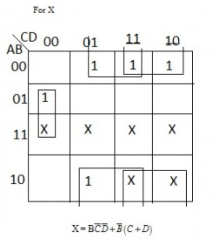
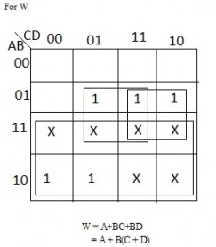
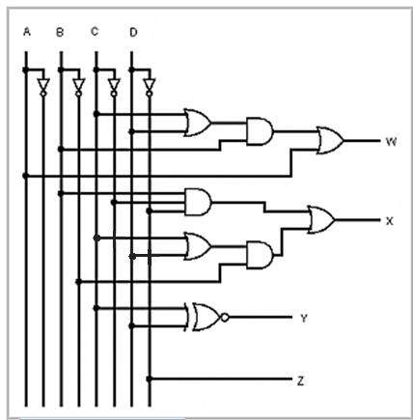
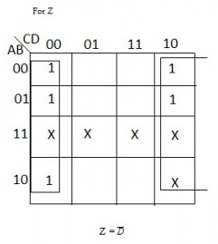
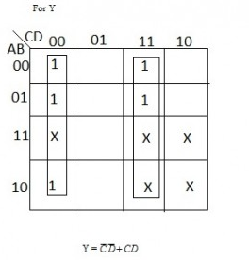
Example 1 [Cont.]
‹#›
Department of Computer Science and Engineering
CSE260 - Digital Logic Design

Slide 24
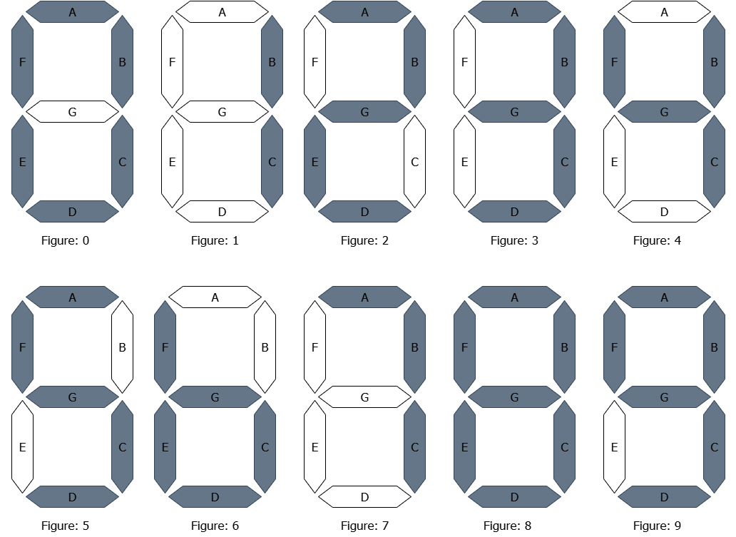
Example
2: 7 segment
display
board
Grey represents that segment is active = 1;
White represents that segment is inactive = 0
‹#›
Department of Computer Science and Engineering
CSE260 - Digital Logic Design

Slide 25
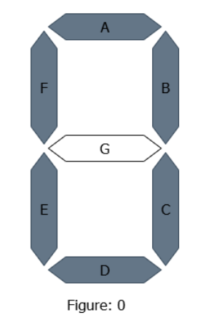
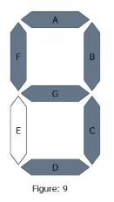
Example
Display Digit | b8 | b4 | b2 | b1 | A | B | C | D | E | F | G
0 | 0 | 0 | 0 | 0 | 1 | 1 | 1 | 1 | 1 | 1 | 0
1 | 0 | 0 | 0 | 1 | 0 | 1 | 1 | 0 | 0 | 0 | 0
2 | 0 | 0 | 1 | 0 | 1 | 1 | 0 | 1 | 1 | 0 | 1
3 | 0 | 0 | 1 | 1 | 1 | 1 | 1 | 1 | 0 | 0 | 1
4 | 0 | 1 | 0 | 0 | 0 | 1 | 1 | 0 | 0 | 1 | 1
5 | 0 | 1 | 0 | 1 | 1 | 0 | 1 | 1 | 0 | 1 | 1
6 | 0 | 1 | 1 | 0 | 0 | 0 | 1 | 1 | 1 | 1 | 1
7 | 0 | 1 | 1 | 1 | 1 | 1 | 1 | 0 | 0 | 0 | 0
8 | 1 | 0 | 0 | 0 | 1 | 1 | 1 | 1 | 1 | 1 | 1
9 | 1 | 0 | 0 | 1 | 1 | 1 | 1 | 1 | 0 | 1 | 1
off | 1 | 0 | 1 | 0 | x | x | x | x | x | x | x
off | 1 | 0 | 1 | 1 | x | x | x | x | x | x | x
off | 1 | 1 | 0 | 0 | x | x | x | x | x | x | x
off | 1 | 1 | 0 | 1 | x | x | x | x | x | x | x
off | 1 | 1 | 1 | 0 | x | x | x | x | x | x | x
off | 1 | 1 | 1 | 1 | x | x | x | x | x | x | x
2: 7 segment
display board
‹#›
Department of Computer Science and Engineering
CSE260 - Digital Logic Design

Slide 26
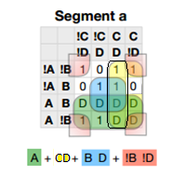
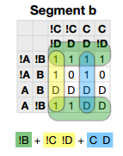
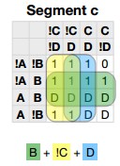
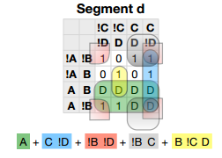
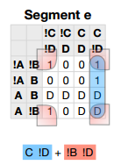
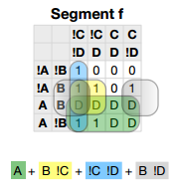
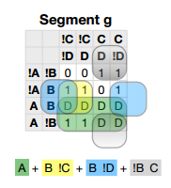
Example 2 [Cont.]
‹#›
Department of Computer Science and Engineering
CSE260 - Digital Logic Design

Slide 27
Example 2 [Cont.]
Draw the circuit
yourself……..
‹#›
Department of Computer Science and Engineering
CSE260 - Digital Logic Design

Slide 28
Try it yourself
A car garage has a front door and one window, each of which has a sensor to detect whether it is open. A third sensor detects whether it is dark outside. A security system for the garage follows this rule:
the alarm rings if the alarm switch is turned on and the side window is not closed and either the front door is not closed or it is dark
‹#›
Department of Computer Science and Engineering
CSE260 - Digital Logic Design

Slide 29
Solution
SwitchOn | Door | Window | Dark | AlarmRing
0 | 0 | 0 | 0 | 0
0 | 0 | 0 | 1 | 0
0 | 0 | 1 | 0 | 0
0 | 0 | 1 | 1 | 0
0 | 1 | 0 | 0 | 0
0 | 1 | 0 | 1 | 0
0 | 1 | 1 | 0 | 0
0 | 1 | 1 | 1 | 0
1 | 0 | 0 | 0 | 0
1 | 0 | 0 | 1 | 0
1 | 0 | 1 | 0 | 0
1 | 0 | 1 | 1 | 1
1 | 1 | 0 | 0 | 0
1 | 1 | 0 | 1 | 0
1 | 1 | 1 | 0 | 1
1 | 1 | 1 | 1 | 1
Assuming
AlarmRing = 1 if Alarm rings, 0 otherwise.
Switch On = 1 if alarm switch is on, 0 otherwise.
Door = 1 if door is not closed, 0 otherwise.
Window = 1 if window is not closed.
Dark = 1 if it is dark outside, 0 otherwise.
‹#›
Department of Computer Science and Engineering
CSE260 - Digital Logic Design

Slide 30
Solution
SwitchOn | Door | Window | Dark | AlarmRing
0 | 0 | 0 | 0 | 0
0 | 0 | 0 | 1 | 0
0 | 0 | 1 | 0 | 0
0 | 0 | 1 | 1 | 0
0 | 1 | 0 | 0 | 0
0 | 1 | 0 | 1 | 0
0 | 1 | 1 | 0 | 0
0 | 1 | 1 | 1 | 0
1 | 0 | 0 | 0 | 0
1 | 0 | 0 | 1 | 0
1 | 0 | 1 | 0 | 0
1 | 0 | 1 | 1 | 1
1 | 1 | 0 | 0 | 0
1 | 1 | 0 | 1 | 0
1 | 1 | 1 | 0 | 1
1 | 1 | 1 | 1 | 1
WDk
SDr
 |  | 1 | 1
 |  | 1
AlarmRing=SWDk+SDrW
Next Step
You do have to draw the circuit for the above function
You may be asked to draw the circuit using basic gates or universal gates
By now, you should be able to do it yourself. So please try.
‹#›
Department of Computer Science and Engineering
CSE260 - Digital Logic Design

Slide 31
y
y
y
x
x
0 1
00 | 01
10 | 11
m₀ | m₁
m₂ | m₃
x’y’ | x’y
xy’ | xy
1 | 1
1
0
1
x
y
y
yz
yz
x
00 01 11 10
x
00 01 11 10
1 |  |  | 1
1 |  |  | 1
m₀ | m₁ | m₃ | m₂
m₄ | m₅ | m₇ | m₆
0
1
0
1
x
x
z
z
‹#›
Department of Computer Science and Engineering
CSE260 - Digital Logic Design

Slide 32
y
y
y
yz
yz
yz
wx
00 01 11 10
wx
00 01 11 10
wx
00 01 11 10
00
01
11
10
0000 | 0001 | 0011 | 0010
0100 | 0101 | 0111 | 0110
1100 | 1101 | 1111 | 1110
1000 | 1001 | 1011 | 1010
1 | 1 |  | 1
1 | 1 |  | 1
1 | 1 |  | 1
1 | 1
w’x’y’z’ | w’x’y’z | w’x’yz | w’x’yz’
w’xy’z’ | w’xy’z | w’xyz | w’xyz’
wxy’z’ | wxy’z | wxyz | wxyz’
wx’y’z’ | wx’y’z | wx’yz | wx’yz’
00
01
11
10
00
01
11
10
x
x
x
w
w
w
z
z
z
‹#›
Department of Computer Science and Engineering
CSE260 - Digital Logic Design

